Slide 1
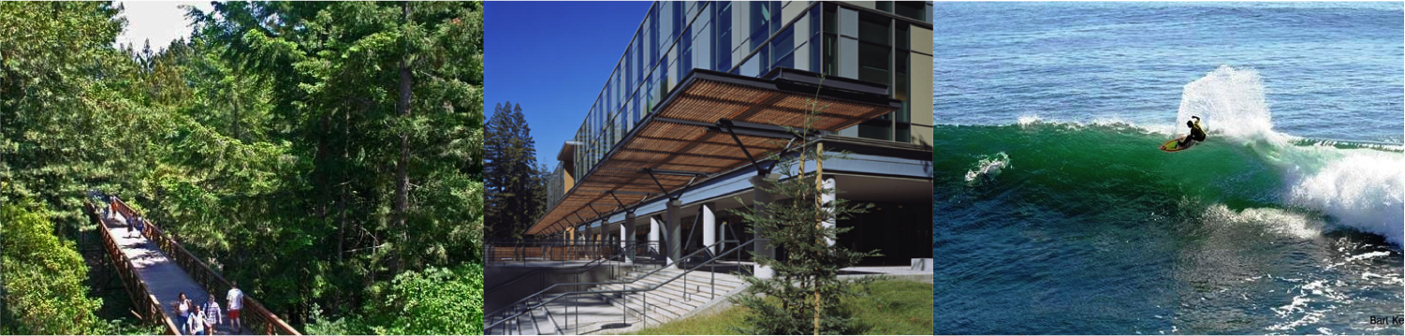

MESO Pathway Analysis
Kiley Graim, Arjun Rao
Center for Biomolecular Science and Engineering,
UC Santa Cruz
July 2015

Slide 2
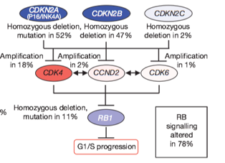
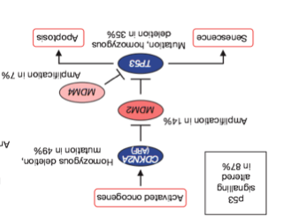

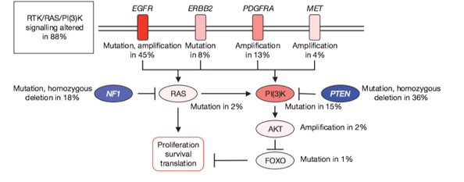
PARADIGM: Data interpretation using a model of gene expression and interaction
MDM2
TP53
Josh Stuart Group
Notes:
Encode mechanistic cause-event
Intuitive and suggestive of further experimentation
Data provide quantification to (someday) simulate

Slide 3
PARADIGM: Data interpretation using a model of gene expression and interaction
Two Parts:
MDM2
Gene Level Model
(central dogma)
2. Interaction Model
(regulation)
TP53
Josh Stuart Group
Notes:
Encode mechanistic cause-event
Intuitive and suggestive of further experimentation
Data provide quantification to (someday) simulate

Slide 4
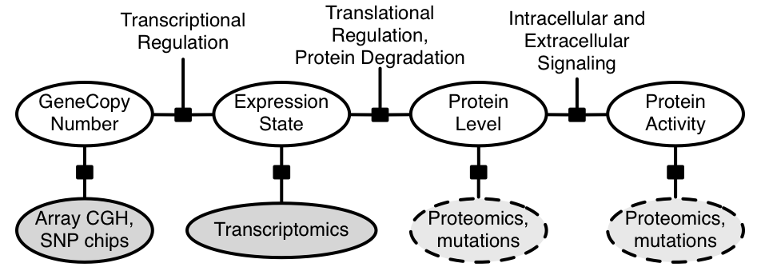
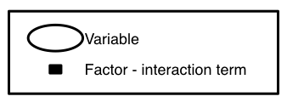
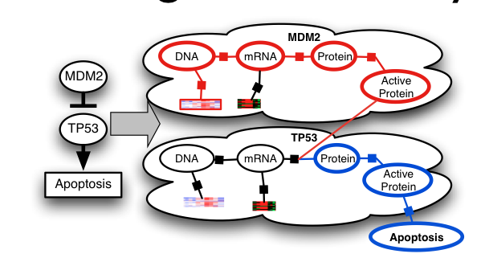
Different Measurements are Integrated Using the Central Dogma
1. Central Dogma-Like Gene Model of Activity
2. Interactions that connect to specific points in gene regulation and signal cascade map
Vaske et al. 2010. Bioinformatics
Notes:
mRNA we can measure, but we want to predict protein activity

Slide 5

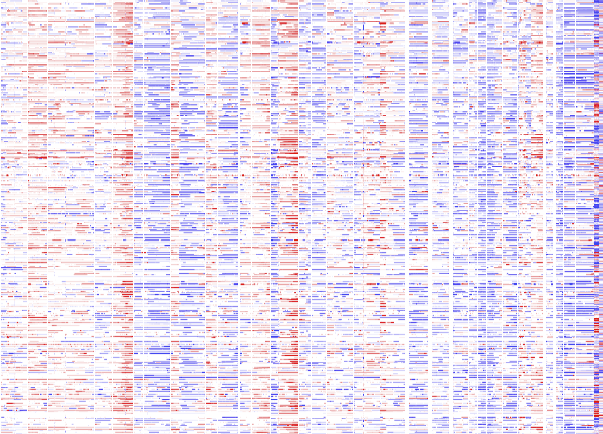
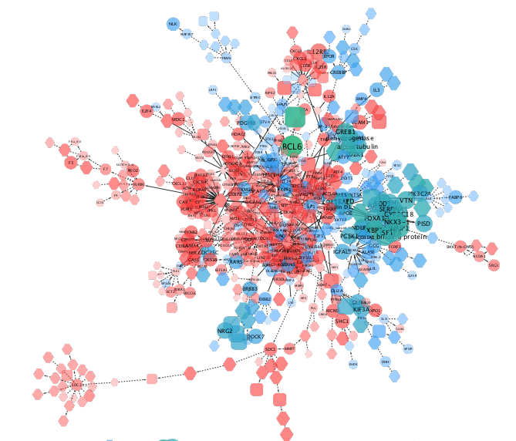
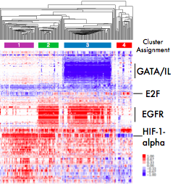
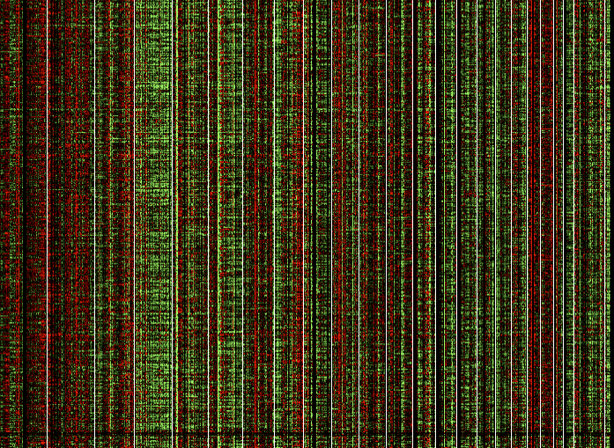

Integrated Pathway Analysis for Cancer
Integrated dataset for downstream analysis
Inferred activities reflect neighborhood of influence around a gene
Can boost signal for survival analysis and assessment of mutation impact
Cohort
Multimodal Data
Pathway Model
of Cancer
Inferred Activities
CNV
mRNA
meth
…
Josh Stuart Group
Notes:
Pathway Inference in the Middle
Arrows pointing out to different uses:
differential marker ID for subtypes
cross-cancer analysis
assess mutations
simulate to infer drug targets

Slide 6
PathMark identifies subnetworks
that distinguish groups

Slide 7
LIHC PathMark:
Cluster 3 vs All
MYC
TP53
JUN/FOS
E2F1/FOXM1
Notes:
2SD filter

Slide 8
LIHC AWG
TP53 Subnetwork
TP53 Mutations

Slide 9
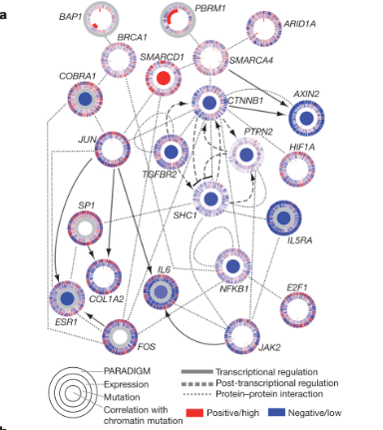
(TieDie) Results on KIRC*
Comprehensive molecular characterization of clear cell renal cell carcinoma, Nature, 2013
Notes:
This is from the KIRC Paper, for comparison, the
Contrast: old and new methods of visualizing pathways.
SWI/SNF chromatin remodelling complex (PBRM1, ARID1A, SMARCA4)
NFKB – cytokine production and cell survival. It’s a rapid acting transcription factor, and coordinates the response to harmful stiumli.
SHC1 – regulation of apoptosis.

